Slide 1
Probabilistic Visitor Stitching on Cross-Device Web Logs
Sourse : WWW 2017
Advisor : JIA-LING KOH
Speaker : YI-CHENG HUNG
Date:2017/11/28

Slide 2
Outline
Introduction
Method
Experiment
Conclusion

Slide 3
Introduction
Motivation
A single user will often access web services from a wide range of devices, including desktop and laptop computers at both home and work, tablets, mobile devices, vehicles, and entertainment systems.
users expect
Services remember their preferences and provide a seamless user experience and interface.
Goal

Slide 4
Introduction
Goal-visitor stitching
Consolidating multiple visits across different devices and sessions into a single user identity.
difficult
users frequently access these services from a mixture of authenticated and anonymous sessions

Slide 5
Method-Data analysis
Company A -7.3 million user accounts
Company B -2.2 million user accounts
remove user accounts that have more than 20 cookie identifiers, which are likely attributed to bot-like activities.
focus on users who access services multiple times
Post-filtering
the number of multiple-cookie owning users is 31K for dataset A, and 270K for dataset B1

Slide 6
Method - Entropy-based Feature Analysis
We define two metrics to assess these features.
Uniqueness(唯一性)
feature values
associated users
Reliability(可信度)

Slide 7
quantify the discriminative power of features available
Uniqueness
based on the entropy over unique users who share a feature value
特徵始終識別同一個用戶
“Uniqueness=1”表示每個feature都跟此user有關聯。
Reliability
based on the entropy of unique feature values observed for a single user.
“Reliability=1”表示每個user都被認為跟此feature有關聯。

Slide 8
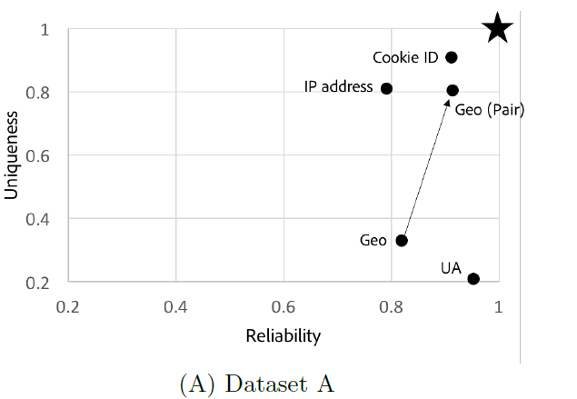
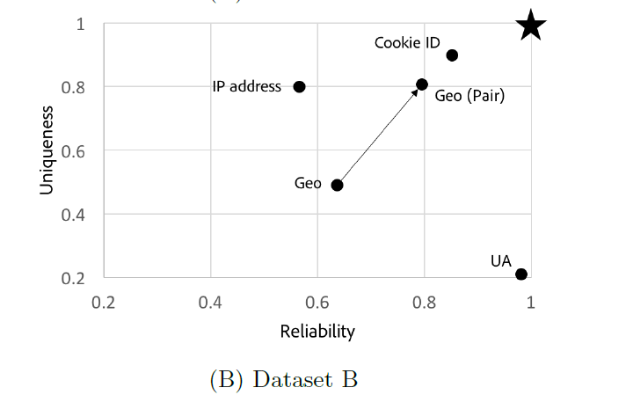

Slide 9
Method- User-Agent Strings & IP Addresses
user-agent string
contains information about the browser and the operating system of the user.
high reliability
because individual users generally use a small set of devices and browsers.
low uniqueness
since many users will have identical user-agent strings(use the same browser and operating system)
IP Addresses
low reliability
users access services from multiple network(多組IP)
high uniqueness
single network will have very few users(ex.同個家庭，使用同一IP，但現在這種情況很少)

Slide 10
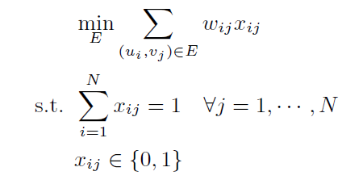
Geographic Locations
less uniqueness and reliability
we simply collapse the top-two most visited locations into a pair of coordinates.
Measuring Geolocation Distance
To utilize the user geo-coordinates for the visitor stitching task, we need to define a similarity measure between users

Slide 11
Probabilistic soft logic framework (PSL)

Slide 12
Probabilistic soft logic framework (PSL)

Slide 13
PSL Models-rules
IP
is computed using the Jaccard coefficient between sets of IP addresses associated with the respective visitors.
US
is computed by first using a hash function to convert the user-agent string into an ID-like string, and also uses the Jaccard coefficient between sets of user-agent strings.

Slide 14
PSL Models-rules
Geo
is computed as described in page 10
IP.UA

Slide 15
PSL Models-rules
Geo.UA
Transitivity

Slide 16
EXPERIMENT-Data preparation
Data preparation
For week 1, we aggregate logs based on a user login information.
For week 2, logs are aggregated based on their cookie identifier.
The training pairs are random samples from the generated pairs, and testing pairs are those not selected for the training set.
Model
compare with Naive Bayes(NB), Logistic Model Tree (LM) , MultiBoosting (MB), and Random Forests (RF).

Slide 18
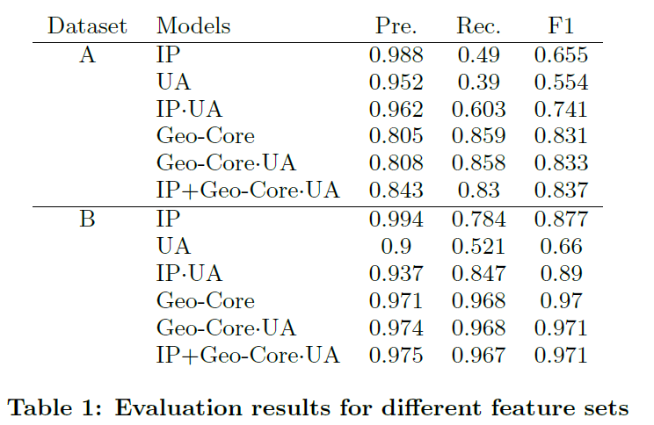
EXPERIMENT-Comparison of feature sets

Slide 19
EXPERIMENT-Comparison with other methods

Slide 20
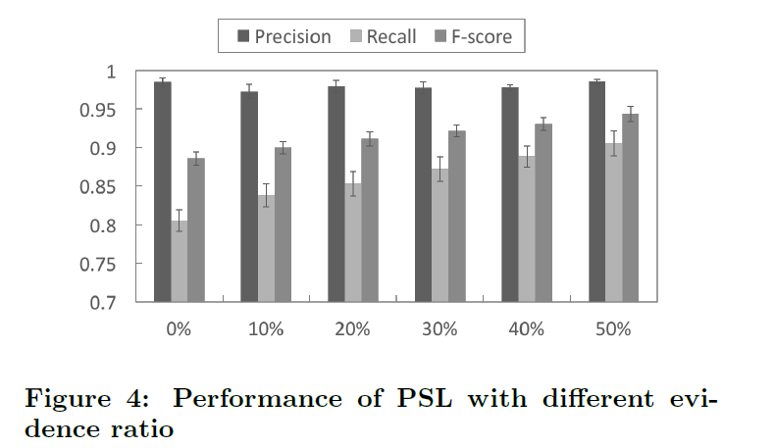
EXPERIMENT-Analysis Results(transitivity rule )
Lack of login information
we have to handle a set of individual cookies which lack user-level information.
we add the transitivity rule with varying amounts of SameUser() evidence(0% to 50% compared to the number of pairs in the testing set).

Slide 21
EXPERIMENT-Analysis Results(transitivity rule )
if two cookie pairs, (A;B) and (B;C), have a strong signal of SameUser(), we can infer that the cookies A and C are also from the same individual even when A and C do not have enough similarity in terms of features.
It shows that even when we do not have enough user-level information, collective inference through PSL can connect cookies based on relational information and improve the prediction accuracy.

Slide 22
CONCLUSION
Address the visitor stitching problem by resolving individual web logs to unique users.
we evaluated our PSL models for visitor stitching on two real-world web logs, and compared them with several state-of-the-art methods.
According to the result, our models achieve F-scores of up to 0.837 and 0.971 on two datasets, which are statistically better scores than the state-of-the-art methods.
our models demonstrate effectiveness in addressing the visitor stitching task across multiple devices.

